Slide 1
What is Data Modeling
Data modeling is the process of organizing data structures, relationships, and rules to support database design and data management.
It involves defining how data is structured, stored, and accessed, using diagrams or models that map out entities, attributes, and relationships.
By organizing data logically and consistently, data modeling helps ensure accuracy, efficiency, and scalability in information systems.
A well-designed data model should also be able to respond to change and handle future requirements.

Slide 2
Why is Data Modeling Important?
Creating a data model is an important step in application development.
It enables your team to decide what data is necessary and how to collect and structure it.
A data model can be considered a set of decisions, assertions, and assumptions. Even if something is modeled incorrectly, those assumptions are written down and help the team understand why it was modeled that way.
With this baseline of information, the team can better determine whether making a change is the right course of action in the future.

Slide 3
Data Model:
A set of concepts to describe the structure of a database, the operations for manipulating these structures, and certain constraints that the database should obey.
Data Model Structure and Constraints:
Constructs are used to define the database structure
Constructs typically include elements (and their data types) as well as groups of elements (e.g. entity, record, table), and relationships among such groups
Constraints specify some restrictions on valid data; these constraints must be enforced at all times

Slide 4
Conceptual vs. logical vs. physical data modeling
A conceptual model provides a high-level system overview, focusing on the main entities and relationships without going into technical details.
A logical model adds more structure by defining data elements, attributes, and their relationships.
A physical model addresses implementation details, specifying how data will be stored in a database’s tables, columns, and indexes.
Here’s how to think of each model in the simplest terms:
Conceptual – the “what” model
Logical – the “how” of the details
Physical – the “how” of the implementation

Slide 5
Conceptual Data Model
The conceptual data model can be considered the “whiteboard” data model. It does not address the “how.”
For this model, it’s important to focus on capturing all the types of data (or “entities”) that the system will need. In addition to entities, a conceptual data model will also capture:
Attributes: Individual properties of an entity. For instance, a “person” entity may have “name” and “shoe size.” An “address” entity may have “zip code” and “city.”
Relationships: How an entity connects to other entities. For instance, a “person” entity may have one or more “addresses.”

Slide 6
Along with the entities, their attributes, and relationships, a conceptual model can also:
Organize scope: Details which entities are included and which are not included.
Define business rules: For instance, are person entities allowed to have multiple addresses? What about multiple emails? Do they need to have a unique identifier?
Architects often create the conceptual data model with business stakeholders and domain experts.

Slide 7
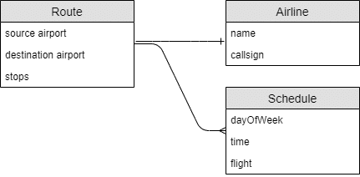
Conceptual Data Model example
There are many “languages” for describing a conceptual data model. But as long as it’s documented in an accessible way, it can be as easy as boxes and arrows.
Here’s a diagram of a conceptual data model that involves two core entities, travel routes (and their associated schedules), and airlines:

Slide 8
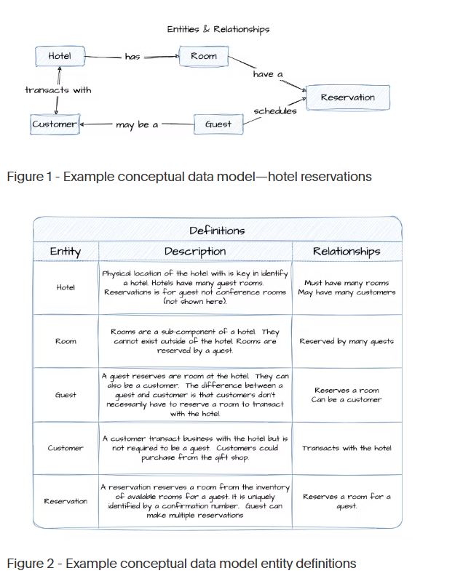
Example: Conceptual Data Model

Slide 9
Benefits of a Conceptual Data Model
Shared understanding
Conceptual data models use simple, business-oriented terminology to describe and define data objects and their relationships, creating a universal language that both technical and non-technical stakeholders can understand.
They also provide visual representations which are easier to understand than written documents, especially for complex relationships.
This shared understanding of the business process is crucial to building stakeholder trust and confidence.
Communication and collaboration
Conceptual models can serve as a focal point for discussions between stakeholders, data teams, and different lines of business, fostering collaboration and trust.
In addition, they can help clarify requirements, identify gaps or redundancies, and promote alignment on business rules and policies.
In short, communication and collaboration lead to trust, which you’ll need when making important decisions on cost, delivery, and functionality.

Slide 10
Logical Data Model
A logical data model is decided upon after stakeholders agree on a conceptual model.
This stage involves filling in the details of the conceptual model. It’s still too early to pick a database management system (DBMS), but this stage can help you decide which database to use (relational, document, etc.). For instance, if you choose relational, you’ll need to decide which tables to create. If you choose document, you’ll need to define the collections.
During this step, you should also decide the details of each field or column and relationship. These details include data types, sizes, lengths, arrays, nested objects, etc.
Architects and business analysts typically create the logical model.

Slide 11
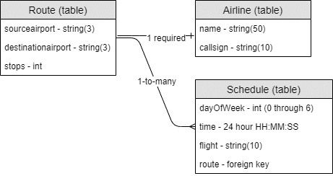
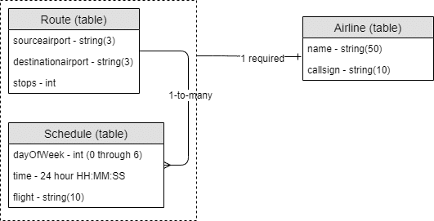
Logical data model example
For instance, if you’re going with a relational
model, the logical model might look like this:
However, with a document database,
the schedule can be modeled directly
as part of the route. There’s no need for a
foreign key, but it’s still helpful to
consider it its own sub-entity. So that
Logical model might look like this:

Slide 12
Benefits of a logical data model
Iterative & Agile: Logical data modeling (LDM) supports agile development by allowing continuous stakeholder feedback and business logic refinement.
Technology-Agnostic: Focuses on data structure & business rules without DBMS constraints.
Clear Structure: Defines data relationships and avoids redundancy—essential for data integrity.
Blueprint for Physical Model: Guides database design for efficient implementation.
Quality Assurance: Detects early errors, aligns with business needs, and reduces long-term costs.
Business Alignment: Enhances communication between analysts, developers, and stakeholders.

Slide 13
What is a physical data model?
A physical data model (PDM) is a data model that represents relational data objects.
It describes the technology-specific and database-specific implementation of the data model and is the last step in transforming from a logical data model to a working database.
A physical data model includes all the needed physical details to build a database.

Slide 14
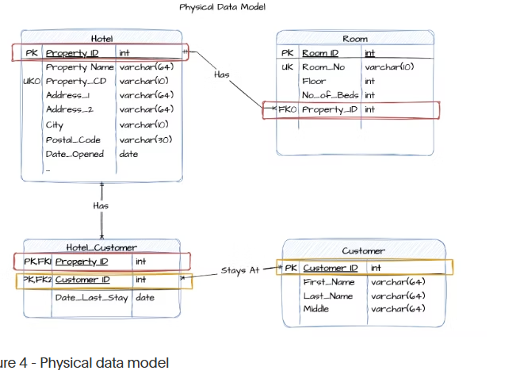

Slide 15
Key Characteristics of Physical Data Model:
Shows Primary Keys (PK) and Foreign Keys (FK)
Specifies data types (like int, varchar, date)
Suitable for implementation in DBMS
Enforces relationships using constraints

Slide 16
Benefits of a physical data model
Speed and efficiency
The physical data model (PDM) is about how your data will be physically stored, structured, and securely accessed, and it’s optimized for the specific cloud data platform or on-premises database. PDMs ensure optimal configuration for cost, scale, storage, and performance. In a world with consumption-based data platforms, having a well-modeled physical data model ultimately saves time, money, and resources.
Scalability and future-proofing
A well-modeled physical data model makes it much easier to manage the inevitable changes as your business grows and evolves.
PDMs provide a blueprint and scalable framework that can accommodate new data sources, business rules, or system integrations, resulting in lower system complexity, reduced obsolescence risk, and faster market speed.

Slide 17
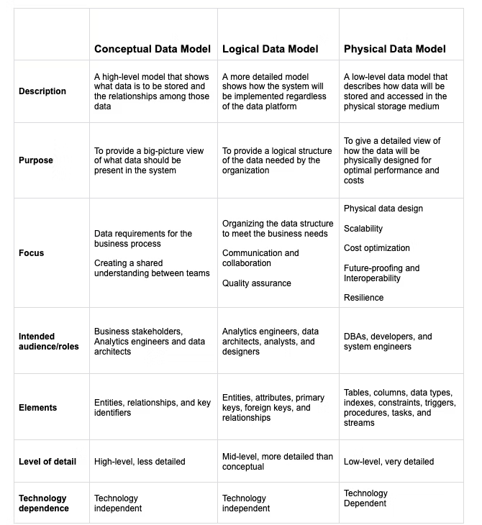

Slide 18
Schemas versus Instances
Database Schema:
The description of a database.
Includes descriptions of the database structure, data types, and the constraints on the database.
Schema Diagram:
An illustrative display of (most aspects of) a database schema.
Schema Construct:
A component of the schema or an object within the schema, e.g., STUDENT, COURSE.

Slide 19
Schemas versus Instances
Database State:
The actual data stored in a database at a particular moment in time. This includes the collection of all the data in the database.
Also called database instance (or occurrence or snapshot).
The term instance is also applied to individual database components, e.g. record instance, table instance, entity instance

Slide 20
Features Schema Vs. Instance
Feature | Schema | Instance
Definition | The structure or blueprint of a database. | The actual data stored in the database at a given time.
Nature | Static – rarely changes. | Dynamic – changes frequently as data is added/removed.
Includes | Tables, columns, data types, relationships, constraints. | Actual rows (records) in the tables.
Example | Definition of Student(Name, RollNo, Class) | Data: ('Ravi', 101, '7th Grade')
Analogy | Like the design of a house. | Like the furniture and people currently inside it.

Slide 21
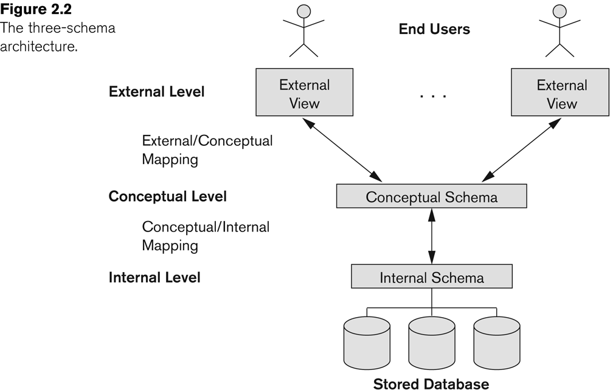
The three-schema architecture

Slide 22
Three-Schema Architecture
🔷 1. External Level (View Level)
This is what end users see.
Each user or group may have a different view of the database (External Views).
It hides complexity and provides customized access.
Example: A student sees only their marks, while an admin sees all students' records.
Multiple end users interact with external views customized for their needs.
🔷 2. Conceptual Level (Logical Level)
Represents the logical structure of the entire database.
Contains all entities, relationships, constraints but hides how data is physically stored.
Acts as a bridge between user views and physical storage.
The conceptual schema connects external views to the internal schema.
🔷 3. Internal Level (Physical Level)
Deals with the physical storage of data: files, indexes, access paths, etc.
Closest to the hardware.
Optimized for performance, storage efficiency, and data retrieval.
The internal schema interacts directly with the stored database (shown as disks).

Slide 23
Mappings in the Architecture
External/Conceptual Mapping
Translates user-specific views into the conceptual schema.
Ensures users only see relevant data.
Conceptual/Internal Mapping
Maps conceptual schema to physical storage.
Ensures logical data models are efficiently stored and retrieved.

Slide 24
Benefits of Three-Schema Architecture
Data Abstraction: Separates user views from storage details.
Data Independence:
Logical Independence: Changes in the conceptual schema don’t affect user views.
Physical Independence: Changes in storage do not affect the logical schema.
Security: Users can be restricted to only certain external views.

Slide 25
Logical Data Independence
Difficult to achieve
You can add, delete, or modify tables, attributes, or relationships in the conceptual schema without affecting user applications.
Example:
Student(RollNo, Name, Class)
Student(RollNo, Name, Class, Email)
User views that only need RollNo, Name, Class don’t need to change.
Applications using old views continue to work as expected.

Slide 26
Physical Data Independence
Easier to achieve
You can change how data is stored (e.g., using indexes, moving to a new disk, compression) without affecting the conceptual schema or applications.
Example: Suppose initially the Student table is stored as a heap file (unordered).Later, for faster access, you store it using a B-tree index or partition the table.
Due to physical data independence: No changes are required in the conceptual schema or user programs.
Queries like SELECT * FROM Student still work the same.

Slide 27
THANK YOU

